Slide 1

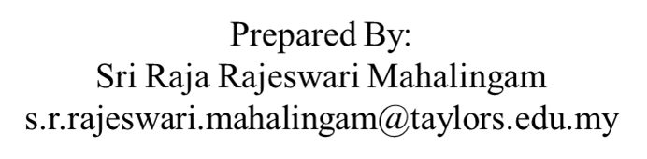
APPLICATION CHEMISTRY
A2 LEVEL
BIOCHEMISTRY
CHAPTER 4:
ATP
&
METALS IN BIOLOGICAL SYATEMS

Slide 2

What you should know…

Slide 3
ATP
The nucleotide, adenosine triphosphate (ATP), has a crucial role to play in making energy available for metabolic reactions in all living organisms.
Short term energy source for cellular activity.
In animal cells this nucleotide is synthesised in the mitochondria of the cell.

Slide 4
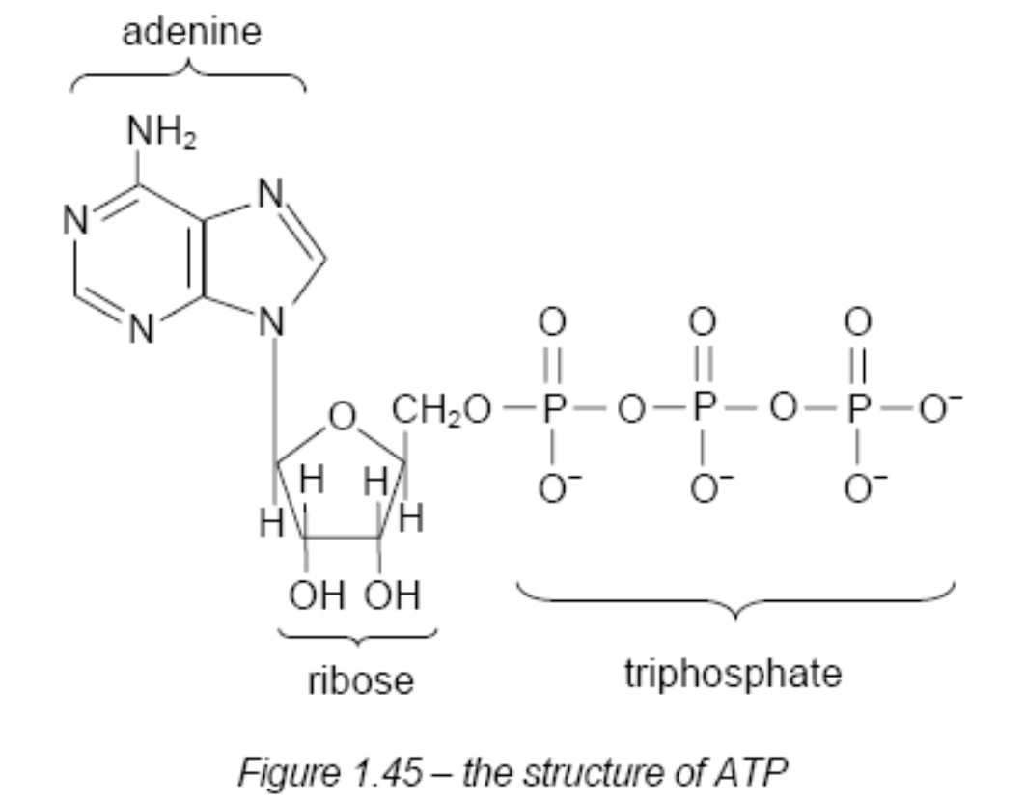
ATP
The molecule consists of
  three phosphate groups linked in a short chain and
  covalently bonded to the hydroxyl group of a sugar, ribose.
  The last part of the molecule is adenine, an organic base.

Slide 5
ATP
The breakdown of ATP is an exothermic reaction and this released energy is used by enzymes to power the catalysed reactions.
ATP is hydrolysed to ADP (adenosine diphosphate) and an inorganic phosphate ion (P_{i})
There is a net gain of energy when the products are formed.
The release of the end phosphate group is favoured by the repulsion between the negatively charged O atoms on the adjacent phosphate groups

Slide 6
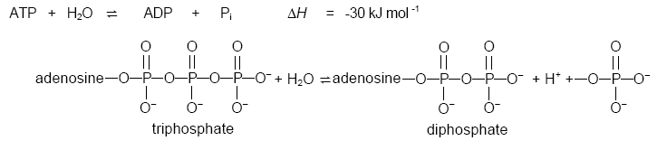
ATP
Chemical transformations and synthetic reactions involving enzymes, ATP plays an essential role.
The proteins involved in ion channels across membranes also require ATP
Metabolic pathways use large amounts of ATP all the time

Slide 7
ATP
Synthesis of ATP - energetically endothermic and this is where the energy available from the oxidation of food is needed.
Plants can make ATP from ADP and phosphate ions using energy from sunlight (photosynthesis).

Slide 8
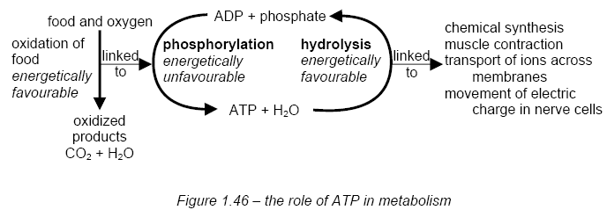
ATP
Respiration is a metabolic process in cells that oxidizes glucose and produces ATP to drive varies cell and tissue activities (Figure 1.46).

Slide 9
ATP
The oxidation of one mole of glucose produces 38 moles of ATP.
The breakdown products of proteins (amino acids) and fats (long-chain carboxylic or fatty acids) in our diet can also ‘feed’ into the respiration pathway at different stages.

Slide 10
ATP
If cellular metabolic activity is to be controlled then spontaneous reactions (hydrolysis of ATP) must not occur in the absence of enzymes.
Although the hydrolysis of ATP to ADP is energetically favourable, the activation energy for the reaction is high.
This means that spontaneous hydrolysis of ATP without the presence of an enzyme does not occur.

Slide 11
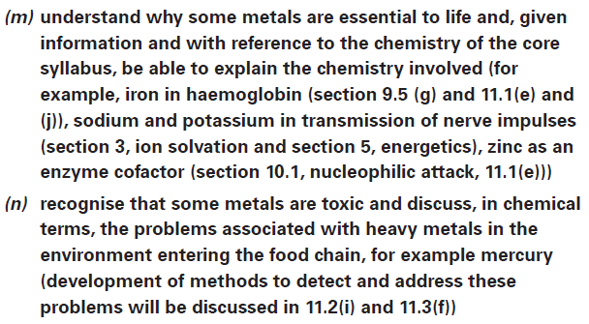
What you should know…

Slide 12
Metals in Biological Systems
Some metals (trace metals) do have vital roles to play in the effective functioning of biological structures and processes.
For example,
Iron is present as an essential component of a range of haem proteins
zinc is a co-factor in over 100 enzyme reactions.

Slide 13
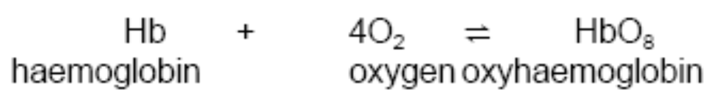
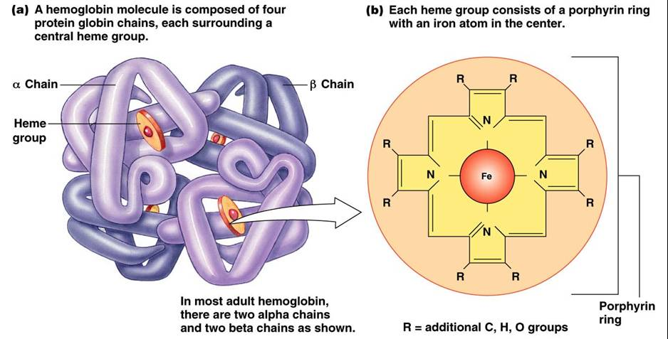
Iron and the haem proteins
It is the Fe²⁺ ions that bind oxygen to the haemoglobin.
Each haem group can bind one oxygen molecule, and each of the four haem groups binds oxygen simultaneously, so the overall reaction is:

Slide 14
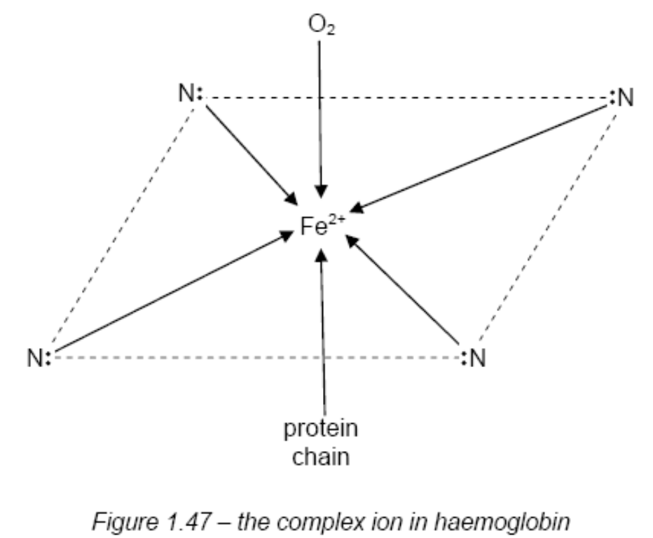
Iron and the haem proteins
Fe²⁺ ions act as the centres of complex ions; the ligands being the haem group, the protein chain, and the attached oxygen molecule
The binding of the oxygen is reversible so that it can be ‘delivered’ to the tissues of the body where it is required.

Slide 15
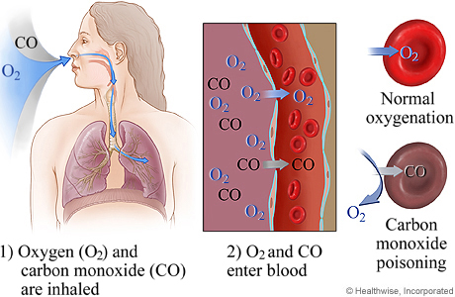
Iron and the haem proteins
Oxygen ligand can be replaced by another ligand that binds more strongly.
In carbon monoxide poisoning the CO molecules replace the oxygen in oxyhaemoglobin.

Slide 16
Iron and the haem proteins
Haem is also involved in the functioning of other proteins such as the cytochromes present in the mitochondria.
These proteins are responsible for the production of ATP in the final stage of the respiration process.
Redox processes involving electron transfer are crucial at this stage and the ability of the Fe²⁺ ions to form Fe³⁺ ions relatively easily, and vice versa, is important here

Slide 17
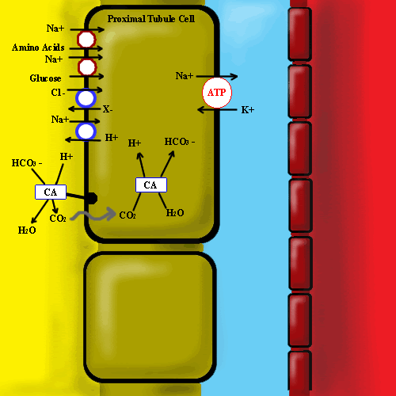
Zinc as an enzyme cofactor
Carbonic anhydrase, present in our red blood cells, it is responsible for the removal of carbon dioxide from the blood, producing hydrogen carbonate ions.
Key to the activity of this enzyme is the zinc ion (Zn²⁺) present in the active site of the enzyme.
The zinc is bound to the enzyme as part of a complex using nitrogen atoms on the protein chain.

Slide 18

Zinc as an enzyme cofactor
Water is also bound to the zinc ion. Since the zinc ion has a high charge density it assists the breakdown of this water molecule into an H⁺ and an OH⁻ ion.
The hydroxide ion is then in a position to attack the carbon dioxide molecule. The product of this nucleophilic attack is the hydrogen carbonate ion which is released from the active site.
Following release of the hydrogen carbonate ion a further water molecule binds to the zinc and the catalytic cycle begins again.

Slide 19
Sodium and potassium ion transfer across cell membranes
Within cells the Na⁺ ion concentration is lower, and the K⁺ ion concentration higher, than the surrounding liquid outside.
When a nerve is stimulated sodium ions pour into the nerve cell.
When this ‘signal’ has passed the Na⁺ and K⁺ ion concentrations have to be restored to normal by the sodium being transported out of the cell once again.
The energy to ‘drive’ this transport has been shown to come from the hydrolysis of ATP.
(enzyme for this reaction Na⁺, K⁺ -ATPase or ‘sodium-potassium pump’)

Slide 20
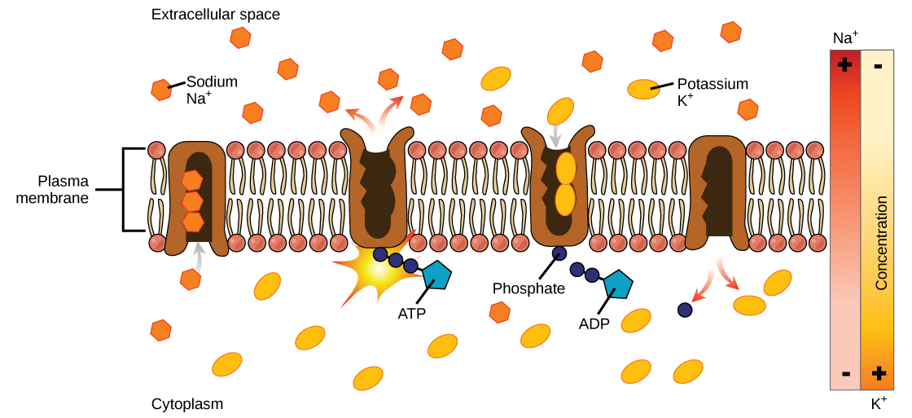
Sodium and potassium ion transfer across cell membranes
These enzyme molecules sit across the membrane with parts of the protein exposed on the outer (extracellular space) and inner surfaces (cytoplasm).
Initially three Na⁺ ions and an ATP molecule bind to the inner protein surface of the enzyme.
ATP is then hydrolysed, with the Pi binding to the protein.
Enzyme changes shape so that the Na⁺ ions move to the outside surface.

Slide 21
Sodium and potassium ion transfer across cell membranes
Two K⁺ ions attach to the protein
Release of the phosphate group from the enzyme results in the K⁺ ions moving into the cell.
When a new ATP molecule attaches to the enzyme, the K⁺ ions are released inside the cell and the cycle of transport can begin again.

Slide 22
The potassium specific channel
There are also specific water and ion channels in cell membranes.
These are also protein structures but the energy required and their selectivity is dependent on the hydration and size of the ions concerned.
The key lies in the fact that the aqueous K⁺ ions (K⁺(aq)) must lose their hydration shells before they can pass through the channel.
The K⁺(aq) ions are stripped of the associated water molecules as they enter the channel, linking instead to oxygen atoms in certain R groups of the protein.

Slide 23
The potassium specific channel
The enthalpy required to lose the hydration shell around the ions is compensated for by that given out when the new association is formed with the protein.
The K⁺ ions pass through the channel and then reassociate with water on the other side.
The selectivity of the channel depends on the distances between the oxygen atoms in the protein side-chains and the K⁺ ions.
The smaller Na⁺ ions will not ‘fit’ the channels as the distances are too great for the complex to form.

Slide 24
Toxic trace metals in the environment
Lead and mercury interfere with enzyme function by disrupting the disulphide bridges involved in protein tertiary structure.
Van der Waals’ forces between non-polar side-chains also contribute to protein tertiary structure. The presence of certain salts can have a disruptive effect on this type of force too.
Ions such as Li⁺, Mg²⁺, and Ca²⁺, together with heavy metal ions such as lead or mercury, have all been shown to interfere with Van der Waals’ interactions.

Slide 25
Toxic trace metals in the environment
Lead used in pipes & leaded petrol
Lead settle on fruits & vegetables
Lead gets into water
Lead is ingested
Mental health problems (young children)
Gastrointestinal problems
Neurological problems
Reproductive problems

Slide 26
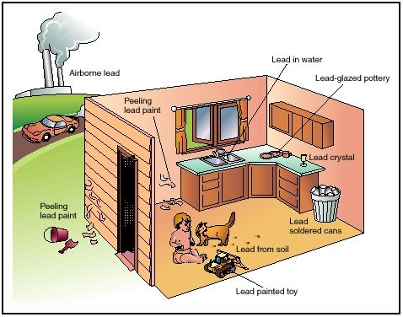
Toxic trace metals in the environment

Slide 27
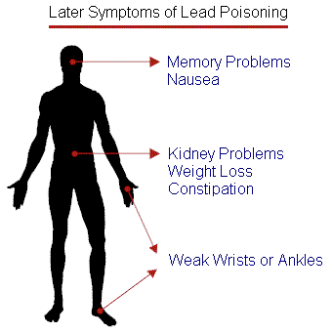
Toxic trace metals in the environment

Slide 28
Toxic trace metals in the environment
Mercury contamination is perhaps the most notorious case of heavy metal poisoning.
Mercury can enter the food chain by a number of routes:
  in waste water discharged into rivers from factories that use mercury compounds in their processes,
  mercury compounds have been used as fungicides and these can be washed off crops into the soil,
  mercury compounds have been used to treat timber and again they can be washed into rivers and streams,

Slide 29
Toxic trace metals in the environment
Mercury cathode cell is one which is used in the large scale production of sodium hydroxide – again any leakage of mercury is dangerous as micro-organisms can convert mercury salts into organomercury compounds e.g. methylmercury salts, and these can be ingested by water-borne organisms.
Here they accumulate and are passed through the food chain, via fish, for instance, and finish up in man.
The effects of mercury toxicity are a loss of muscle co-ordination and mental function.

